Slide 1

50.039 Theory and Practice of Deep Learning W4-S1 Introduction to Computer Vision and Convolutional Neural Networks
Matthieu De Mari

Slide 2
About this week (Week 4)
XXX

Slide 3
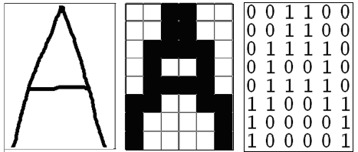
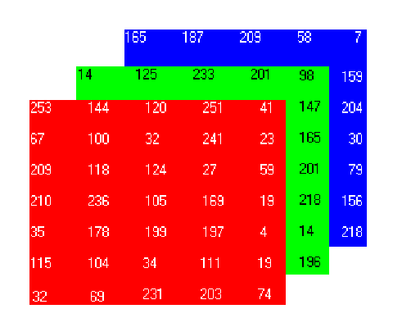
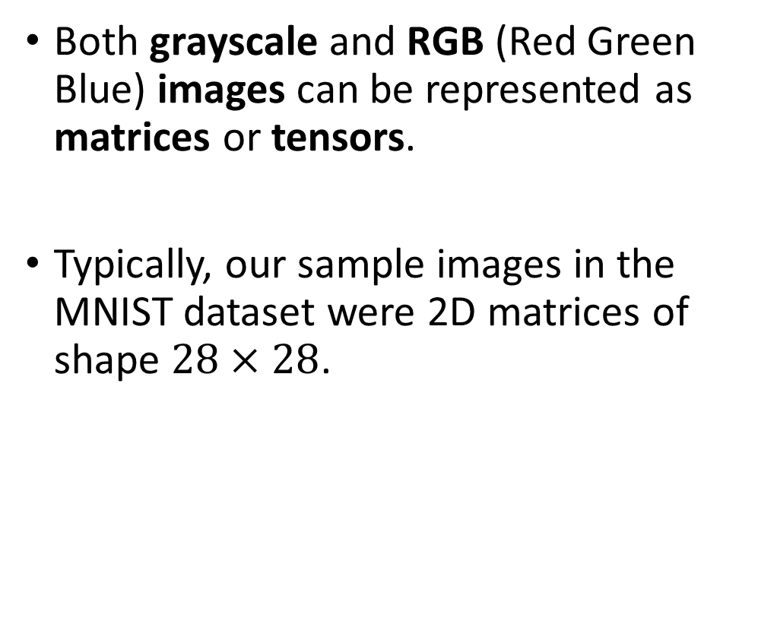
How to encode an image
Both grayscale and RGB (Red Green Blue) images can be represented as matrices or tensors.
Typically, our sample images in the MNIST dataset were 2D matrices of shape $28×28$.

Slide 4
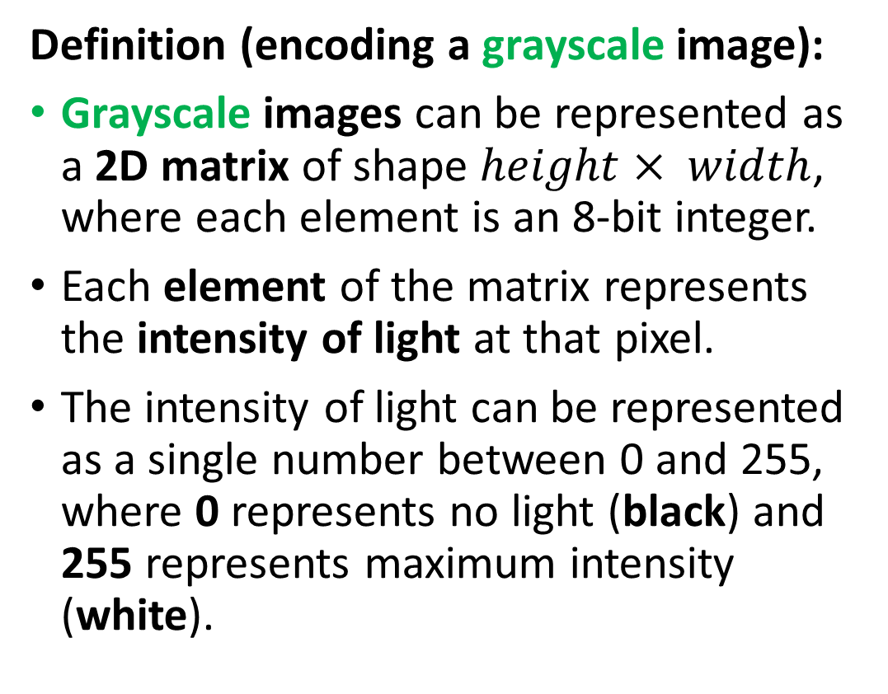
How to encode an image
Definition (encoding a grayscale image):
Grayscale images can be represented as a 2D matrix of shape $height× width$, where each element is an 8-bit integer.
Each element of the matrix represents the intensity of light at that pixel.
The intensity of light can be represented as a single number between 0 and 255, where 0 represents no light (black) and 255 represents maximum intensity (white).

Slide 5
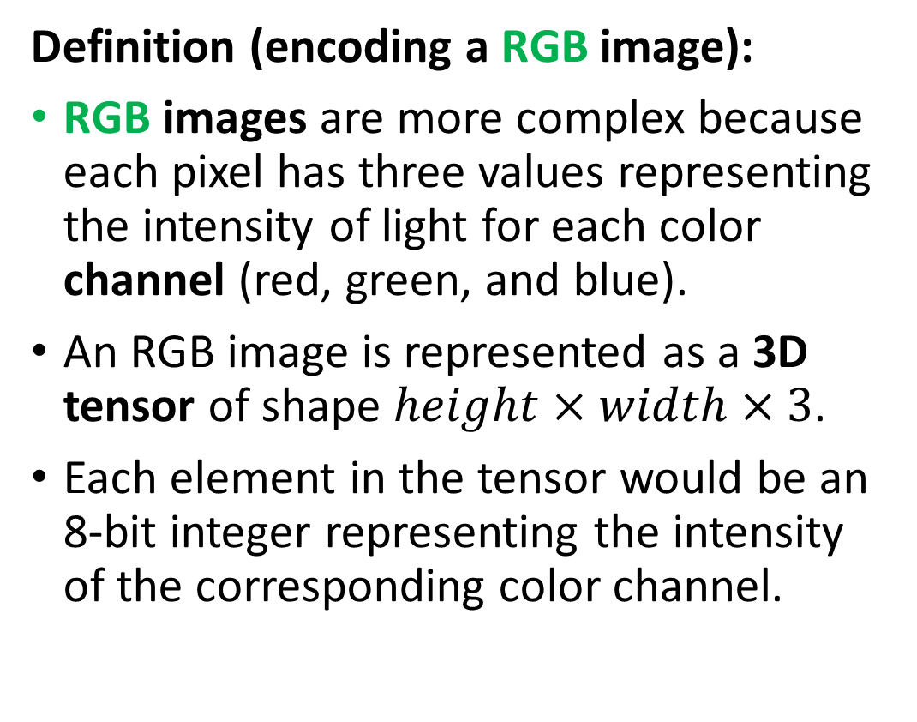
How to encode an image
Definition (encoding a RGB image):
RGB images are more complex because each pixel has three values representing the intensity of light for each color channel (red, green, and blue).
An RGB image is represented as a 3D tensor of shape $height×width×3$.
Each element in the tensor would be an 8-bit integer representing the intensity of the corresponding color channel.

Slide 6
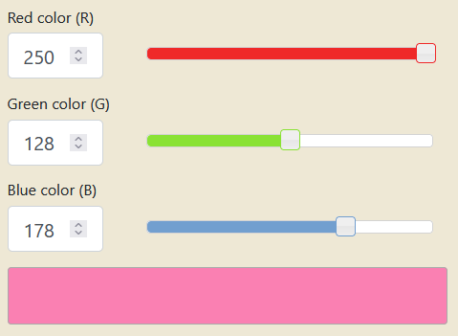
How to encode an image
Combining the red, green and blue values allows to generate any color. Try it!
https://www.rapidtables.com/convert/color/rgb-to-hex.html

Slide 7
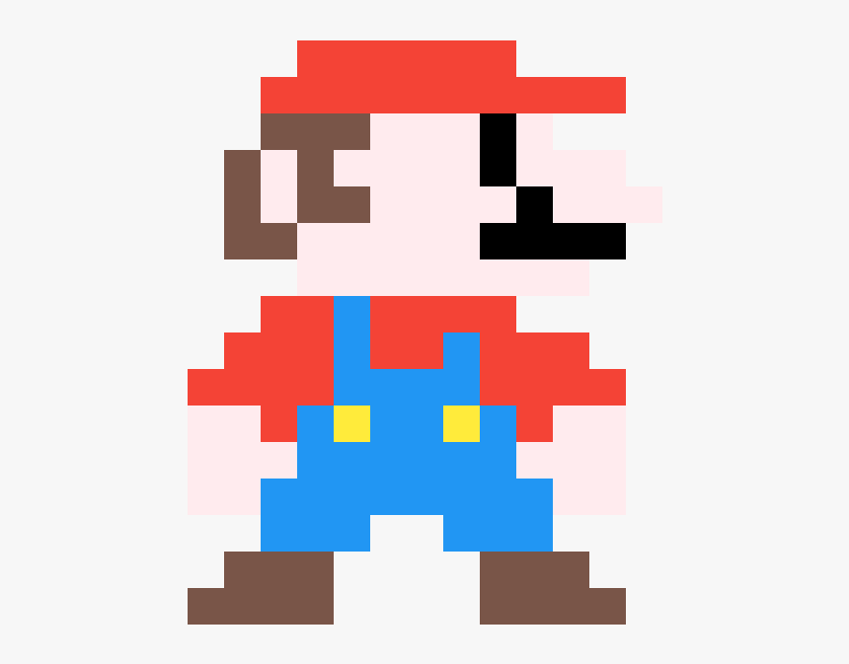
Pixels information
Each element in a Greyscale matrix or RGB matrix corresponds to a pixel, representing something in the image.
The problem, however, is that it is often impossible to guess the meaning of a given pixel, by looking at a pixel alone.

Slide 8
Pixels information
Can you guess what this pixel represents and what object it belongs to?
Flower petal
Piece of clothing
Skin of a human person
Feather of a bird

Slide 9
Pixels information
What if I show you some neighbouring pixels now?
Flower petal
Piece of clothing
Skin of a human person
Feather of a bird

Slide 10
Pixels information
What if I show you MORE neighbouring pixels now?
Flower petal
Piece of clothing
Skin of a human person
Feather of a bird

Slide 11
Pixels information
What if I show you MORE neighbouring pixels now?
Flower petal
Piece of clothing
Skin of a human person
Feather of a bird

Slide 12
The spatial dependence property
Definition (the spatial dependence property of pixels):
The spatial dependence property of pixels states that the meaning or interpretation of a single pixel in an image can often only be understood in the context of the pixels around it.
This is because the information in a single pixel is often not enough to describe the complete picture, or even just the pixel itself.
The relationship between the given pixel and its neighbouring pixels is necessary to provide a full understanding of this particular pixel, or even the image as a whole.
This is something we observed in the Mario pixel art example.

Slide 13
The homophily property
Definition (the homophily property of pixels):
Homophily in images refers to the phenomenon where pixels that are close to each other in space tend to have similar properties, such as color, texture, or intensity. In other words, is the tendency for similar pixels to be grouped together.
For example, in an image of a sky, pixels that are close to each other and have a similar blue color can often be grouped together and be considered part of the sky region.
This property is a key factor in image processing and computer vision algorithms, as it provides a way to segment images into meaningful regions and perform tasks like object recognition and image classification.

Slide 14
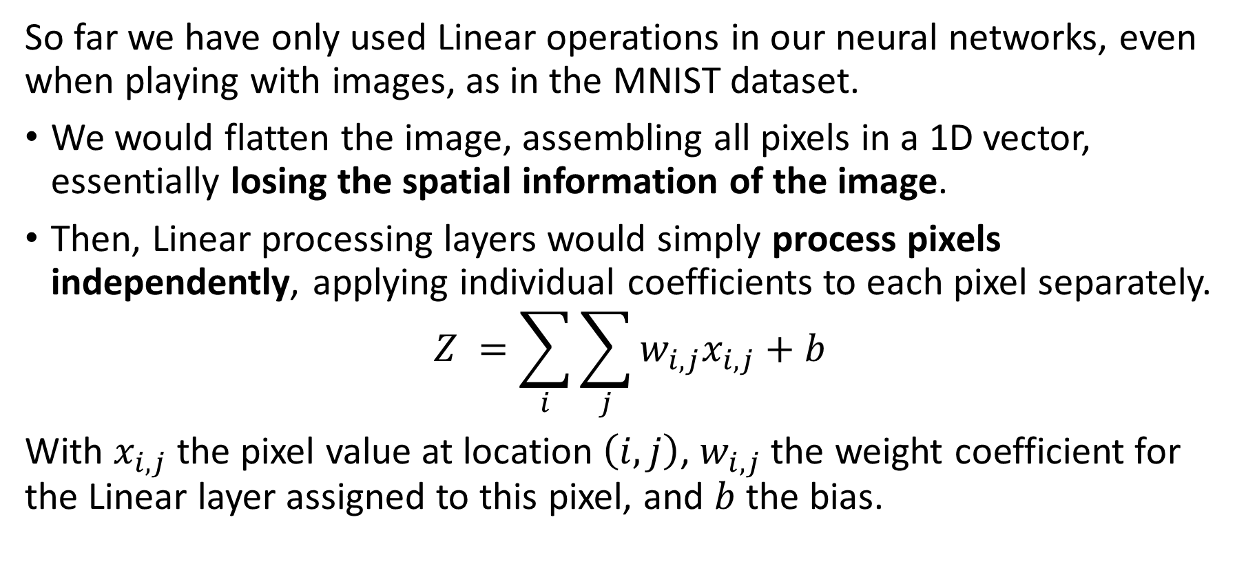
The problem with Linear processing
So far we have only used Linear operations in our neural networks, even when playing with images, as in the MNIST dataset.
We would flatten the image, assembling all pixels in a 1D vector, essentially losing the spatial information of the image.
Then, Linear processing layers would simply process pixels independently, applying individual coefficients to each pixel separately.
$$Z =\sum_{i}{\sum_{j}{w_{i,j}x_{i,j}+b}}$$
With $x_{i,j}$ the pixel value at location $\left(i,j\right)$, $w_{i,j}$ the weight coefficient for the Linear layer assigned to this pixel, and $b$ the bias.

Slide 15
The problem with Linear processing
Linear layers are not great at processing images because they do not take into account the spatial dependence of pixels.
Pixels in images are typically related to each other in a spatial manner, i.e. the meaning of a pixel depends on the neighbour pixels.
Unfortunately, linear models would assume each pixel is independent of the others and process them independently, which is not correct.
As a result, linear layers can miss important spatial relationships between pixels. This can, in turn, result in poor image representation and interpretation.
→ Need for a more specific processing operation for images, to use in place of the Linear one!

Slide 16
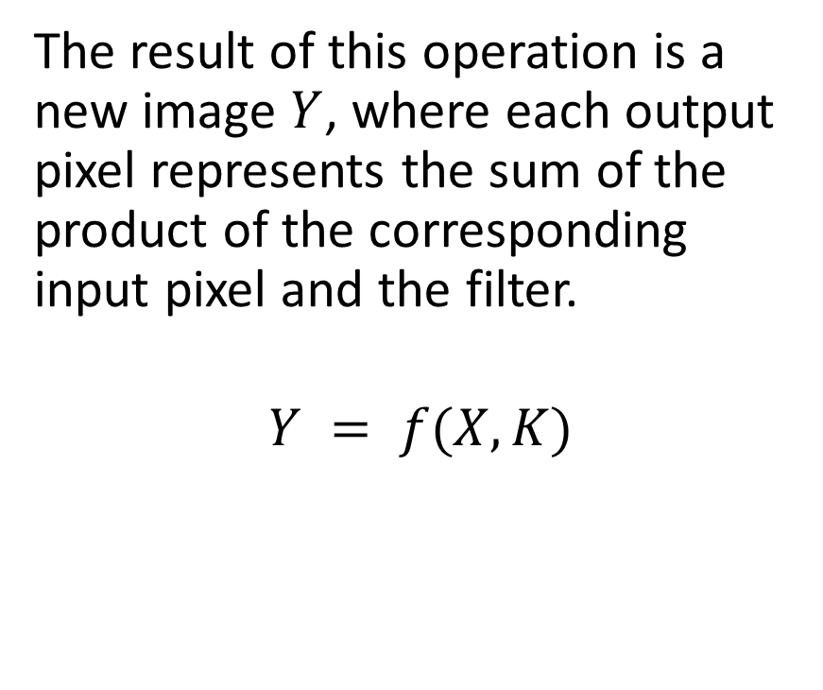
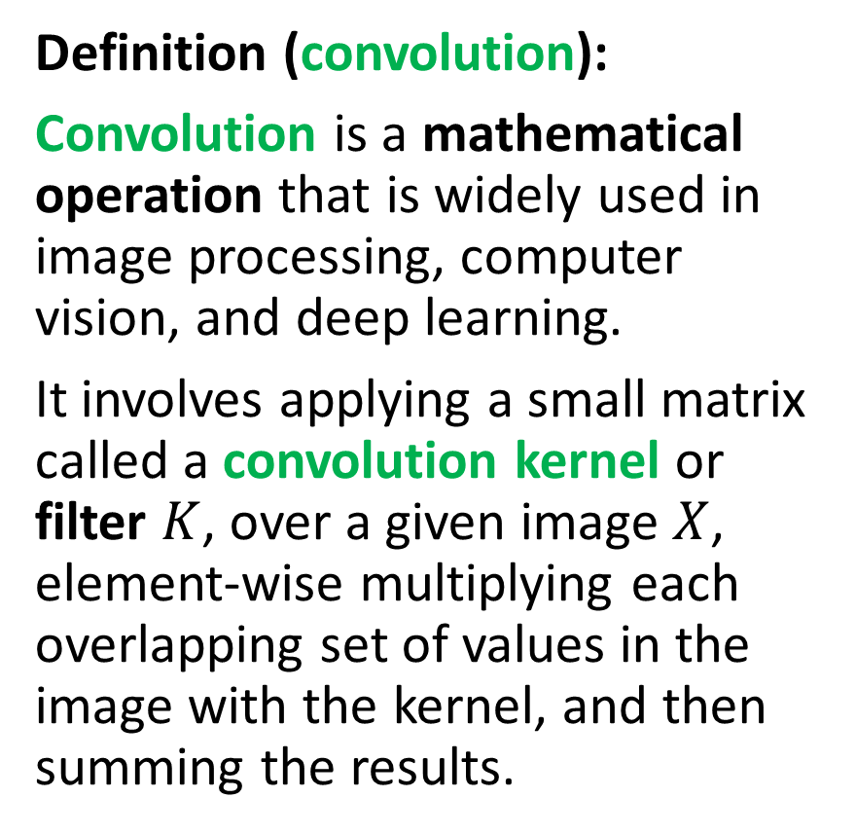
Introducing convolution!
Definition (convolution):
Convolution is a mathematical operation that is widely used in image processing, computer vision, and deep learning.
It involves applying a small matrix called a convolution kernel or filter $K$, over a given image $X$, element-wise multiplying each overlapping set of values in the image with the kernel, and then summing the results.
The result of this operation is a new image $Y$, where each output pixel represents the sum of the product of the corresponding input pixel and the filter.
$$Y = f(X, K)$$

Slide 17
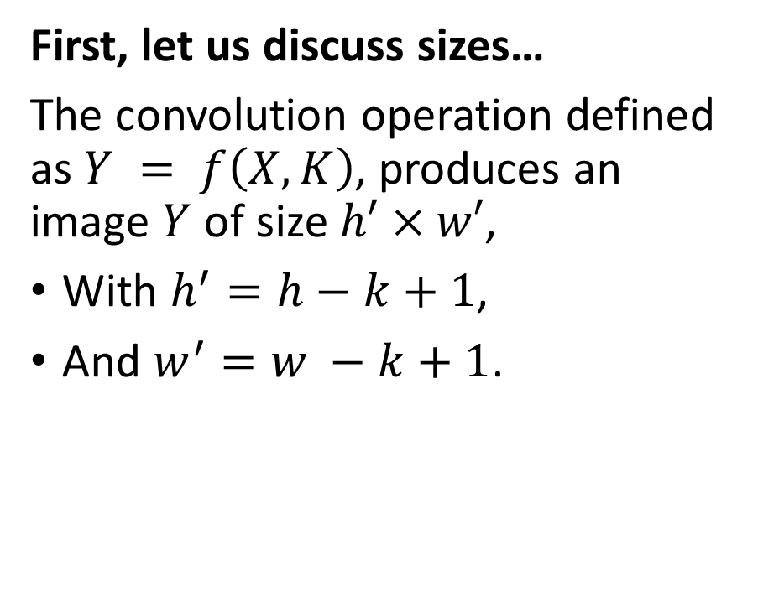
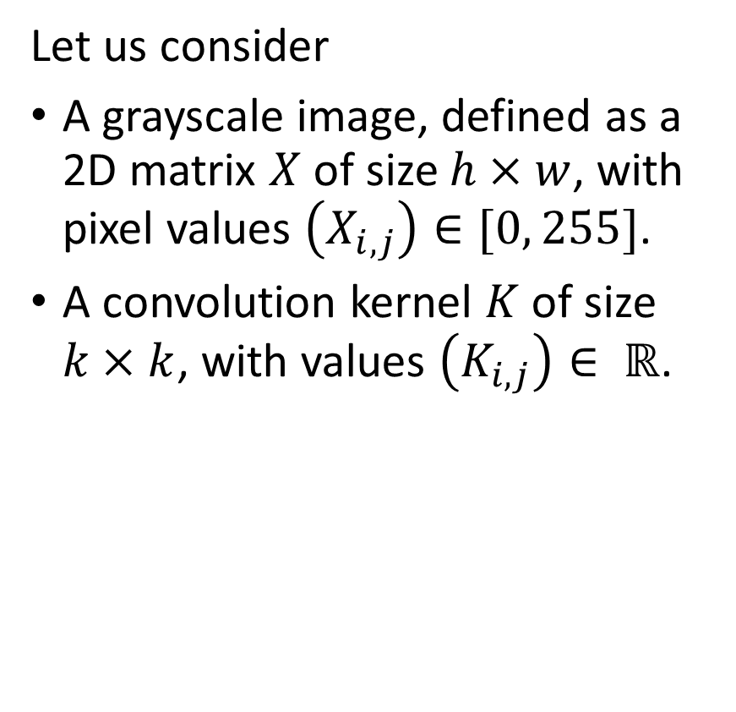
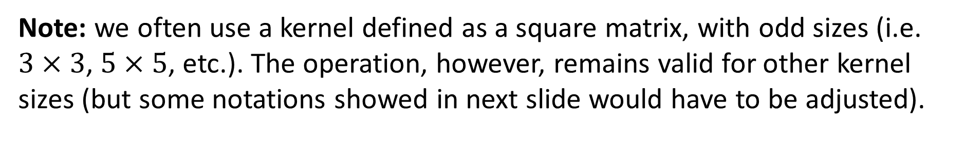
Introducing convolution!
Let us consider
A grayscale image, defined as a 2D matrix $X$ of size $h×w$, with pixel values $\left(X_{i,j}\right)∈[0, 255]$.
A convolution kernel $K$ of size $k×k$, with values $\left(K_{i,j}\right)∈ ℝ$.
First, let us discuss sizes…
The convolution operation defined as $Y = f\left(X, K\right)$, produces an image $Y$ of size $h′×w′$,
With $h^{′}=h−k+1$,
And $w^{′}=w −k+1$.
Note: we often use a kernel defined as a square matrix, with odd sizes (i.e. $3×3$, $5×5$, etc.). The operation, however, remains valid for other kernel sizes (but some notations showed in next slide would have to be adjusted).

Slide 18

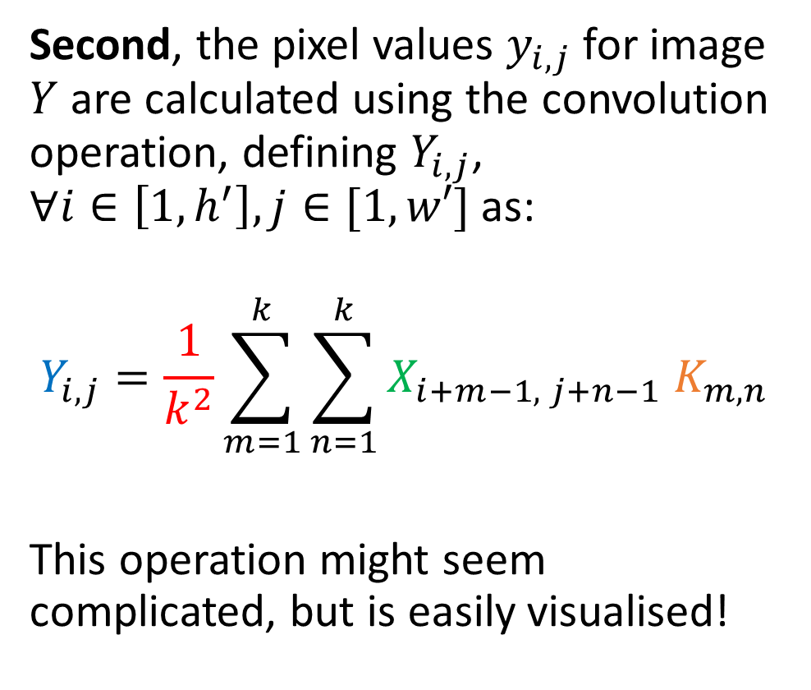


Introducing convolution!
1 | 2 | 4 | 2 | 1
4 | 7 | 3 | 2 | 1
4 | 5 | 2 | 3 | 1
2 | 1 | 7 | 8 | 4
3 | 2 | 4 | 7 | 8
X is 5 by 5
K is 3 by 3
Y is therefore 3 by 3.
(5-3+1 = 3)
$$X$$
Second, the pixel values $y_{i,j}$for image $Y$ are calculated using the convolution operation, defining $Y_{i,j}$, $∀i∈\left[1, h^{′}\right], j∈[1,w′]$ as:
$$Y_{i,j}=\frac{1}{k^{2}}\sum_{m=1}^{k}{\sum_{n=1}^{k}{X_{i+m−1, j+n−1} K_{m,n}}}$$
This operation might seem complicated, but is easily visualised!
1 | 0 | 1
0 | 2 | 1
1 | 0 | 1
$$K$$
… | … | …
… | … | …
… | … | …
$$Y$$

Slide 19

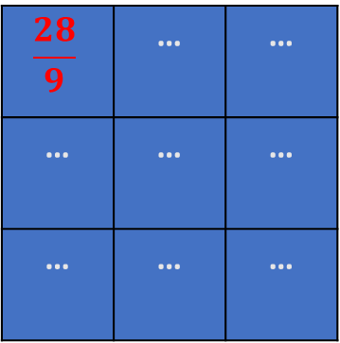
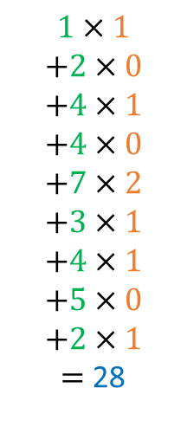
Introducing convolution!
1 | 2 | 4 | 2 | 1
4 | 7 | 3 | 2 | 1
4 | 5 | 2 | 3 | 1
2 | 1 | 7 | 8 | 4
3 | 2 | 4 | 7 | 8
$$1×1$$
$$+2×0$$
$$+4×1$$
$$+4×0$$
$$+7×2$$
$$+3×1$$
$$+4×1$$
$$+5×0$$
$$+2×1$$
$=$ 28
$$X$$
Second, the pixel values $y_{i,j}$for image $Y$ are calculated using the convolution operation, defining $Y_{i,j}$, $∀i∈\left[1, h^{′}\right], j∈[1,w′]$ as:
$$Y_{i,j}=\frac{1}{k^{2}}\sum_{m=1}^{k}{\sum_{n=1}^{k}{X_{i+m−1, j+n−1} K_{m,n}}}$$
This operation might seem complicated, but is easily visualised!
1 | 0 | 1
0 | 2 | 1
1 | 0 | 1
$$K$$
$$\frac{28}{9}$$ | … | …
… | … | …
… | … | …
$$Y$$

Slide 20
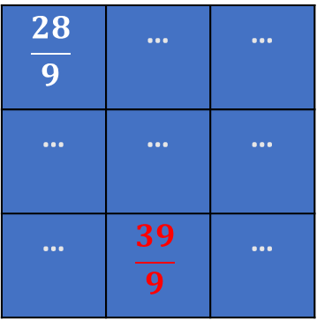
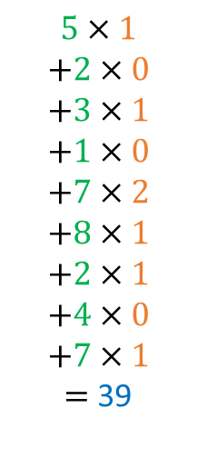
Introducing convolution!
1 | 2 | 4 | 2 | 1
4 | 7 | 3 | 2 | 1
4 | 5 | 2 | 3 | 1
2 | 1 | 7 | 8 | 4
3 | 2 | 4 | 7 | 8
$$5×1$$
$$+2×0$$
$$+3×1$$
$$+1×0$$
$$+7×2$$
$$+8×1$$
$$+2×1$$
$$+4×0$$
$$+7×1$$
$=$ 39
$$X$$
Second, the pixel values $y_{i,j}$for image $Y$ are calculated using the convolution operation, defining $Y_{i,j}$, $∀i∈\left[1, h^{′}\right], j∈[1,w′]$ as:
$$Y_{i,j}=\frac{1}{k^{2}}\sum_{m=1}^{k}{\sum_{n=1}^{k}{X_{i+m−1, j+n−1} K_{m,n}}}$$
This operation might seem complicated, but is easily visualised!
1 | 0 | 1
0 | 2 | 1
1 | 0 | 1
$$K$$
$$\frac{28}{9}$$ | … | …
… | … | …
… | $$\frac{39}{9}$$ | …
$$Y$$

Slide 21

Introducing convolution!
1 | 2 | 4 | 2 | 1
4 | 7 | 3 | 2 | 1
4 | 5 | 2 | 3 | 1
2 | 1 | 7 | 8 | 4
3 | 2 | 4 | 7 | 8
$$5×1$$
$$+2×0$$
$$+3×1$$
$$+1×0$$
$$+7×2$$
$$+8×1$$
$$+2×1$$
$$+4×0$$
$$+7×1$$
$=$ 39
$$X$$
Second, the pixel values $y_{i,j}$for image $Y$ are calculated using the convolution operation, defining $Y_{i,j}$, $∀i∈\left[1, h^{′}\right], j∈[1,w′]$ as:
$$Y_{i,j}=\frac{1}{k^{2}}\sum_{m=1}^{k}{\sum_{n=1}^{k}{X_{i+m−1, j+n−1} K_{m,n}}}$$
1 | 0 | 1
0 | 2 | 1
1 | 0 | 1
$$K$$
$$\frac{28}{9}$$ | … | …
… | … | …
… | $$\frac{39}{9}$$ | …
$$Y$$
Note: Sometimes, the normalization term is removed and we may instead normalize the kernel (ensuring elements in kernel matrix sum up to 1), or not.

Slide 22
Introducing convolution!
1 | 2 | 4 | 2 | 1
4 | 7 | 3 | 2 | 1
4 | 5 | 2 | 3 | 1
2 | 1 | 7 | 8 | 4
3 | 2 | 4 | 7 | 8
$$5×1$$
$$+2×0$$
$$+3×1$$
$$+1×0$$
$$+7×2$$
$$+8×1$$
$$+2×1$$
$$+4×0$$
$$+7×1$$
$=$ 39
$$X$$
Second, the pixel values $y_{i,j}$for image $Y$ are calculated using the convolution operation, defining $Y_{i,j}$, $∀i∈\left[1, h^{′}\right], j∈[1,w′]$ as:
$$Y_{i,j}=\frac{1}{k^{2}}\sum_{m=1}^{k}{\sum_{n=1}^{k}{X_{i+m−1, j+n−1} K_{m,n}}}$$
1 | 0 | 1
0 | 2 | 1
1 | 0 | 1
$$K$$
$$\frac{28}{9}$$ | … | …
… | … | …
… | $$\frac{39}{9}$$ | …
$$Y$$
→ At the end of the day, convolution is just another type of matrix multiplication!

Slide 23
Convolution and Image Processing courses
Convolution is a key mathematical operation that is widely used in computer vision and image processing to modify the apply a wide range of transformations on an image (enhancing contrast, blurring, edge detection, Instagram filters, etc).
If Computer Vision is a direction that interests you, I would strongly advise to take a course on Image Processing (with implementations in OpenCV, Photoshop, etc.) during your continued learning.
For instance: https://www.udemy.com/course/digital-image-processing-from-ground-up-in-python/

Slide 24
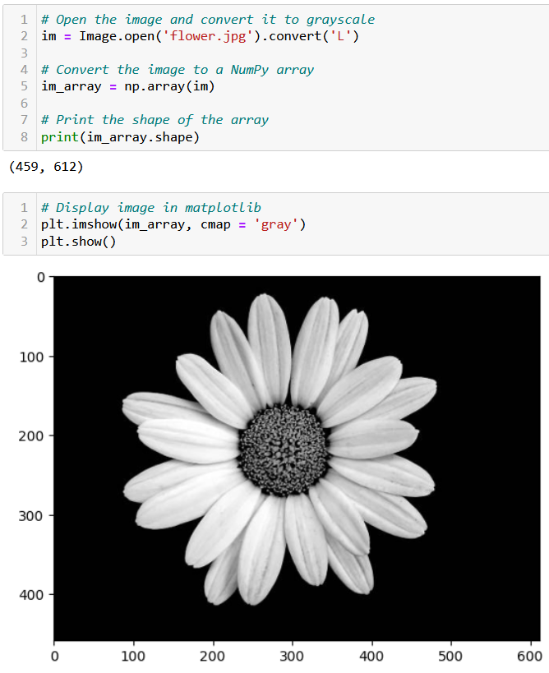
Testing convolution on images
Let us try the convolution operation on images to see their effect.
First, we need a greyscale image.

Slide 25
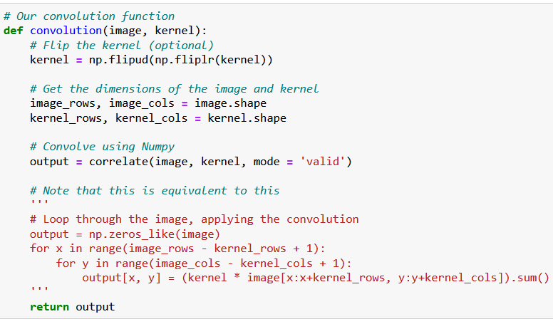
Testing convolution on images
Let us try the convolution operation on images to see their effect.
First, we need a greyscale image.
Second, we need a convolution function.

Slide 26
Testing convolution on images
What is the purpose of flipping the kernel?
Optional, but in short, flipping the kernel has mathematical and practical advantages that make it a common practice in deep learning
(It has to do with signal processing, Fast Fourier Transform and the convolution theorem, out-of-scope).
https://stackoverflow.com/questions/45152473/why-is-the-convolutional-filter-flipped-in-convolutional-neural-networks

Slide 27
Testing convolution on images
Let us try the convolution operation on images to see their effect.
First, we need a greyscale image.
Second, we need a convolution function.
The magic for the transformation then happens when deciding on which kernel to use.

Slide 28
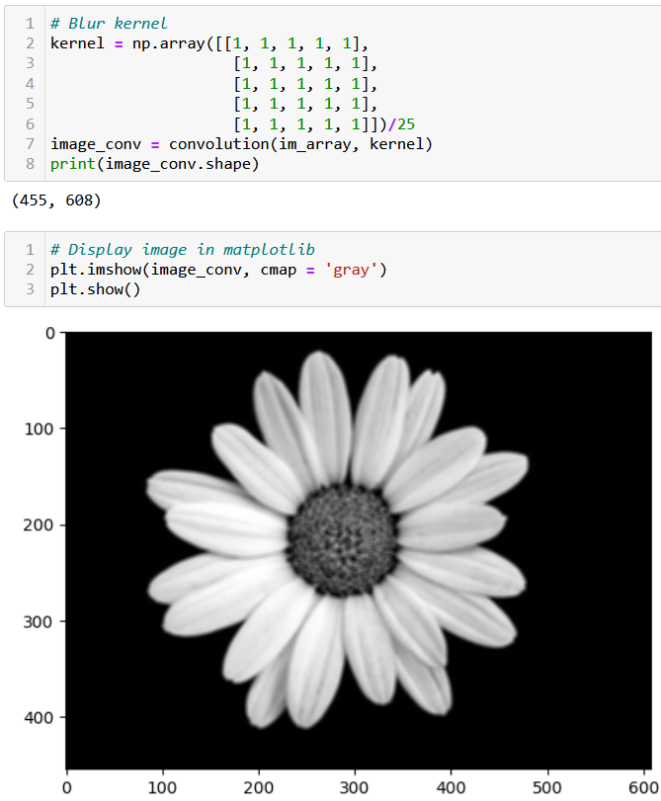
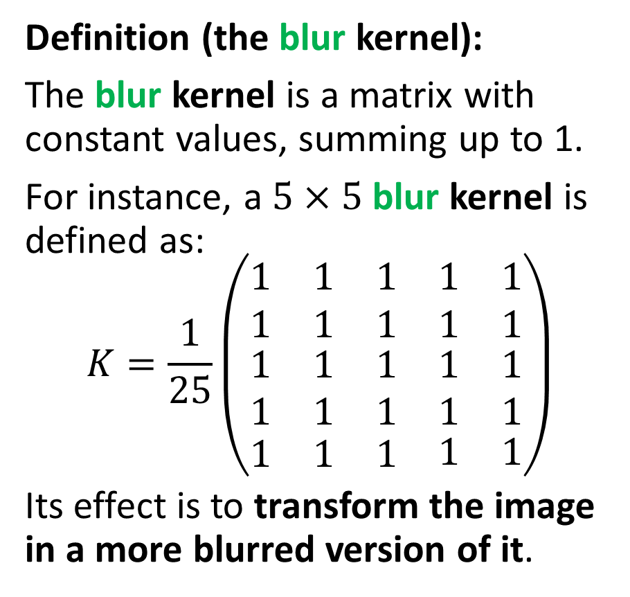
Testing convolution on images
Definition (the blur kernel):
The blur kernel is a matrix with constant values, summing up to 1.
For instance, a $5×5$ blur kernel is defined as:
$$K=\frac{1}{25}\left(\begin{matrix}\begin{matrix}1 & 1 & 1 \\ 1 & 1 & 1\end{matrix} & \begin{matrix}1 \\ 1\end{matrix} & \begin{matrix}1 \\ 1\end{matrix} \\ \begin{matrix}1 & 1 & 1 \\ 1 & 1 & 1\end{matrix} & \begin{matrix}1 \\ 1\end{matrix} & \begin{matrix}1 \\ 1\end{matrix} \\ \begin{matrix}1 & 1 & 1\end{matrix} & 1 & 1\end{matrix}\right)$$
Its effect is to transform the image in a more blurred version of it.

Slide 30
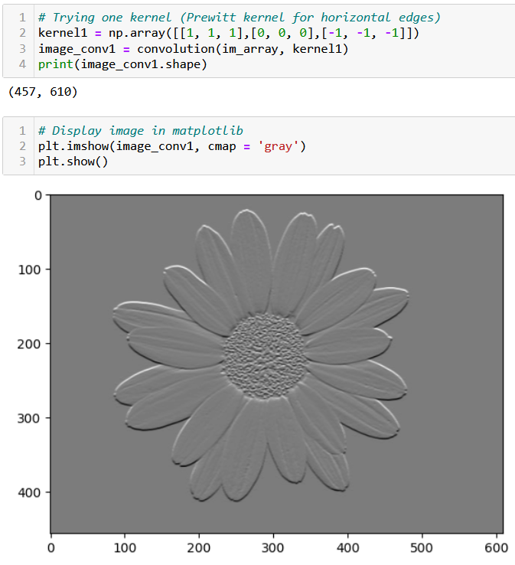
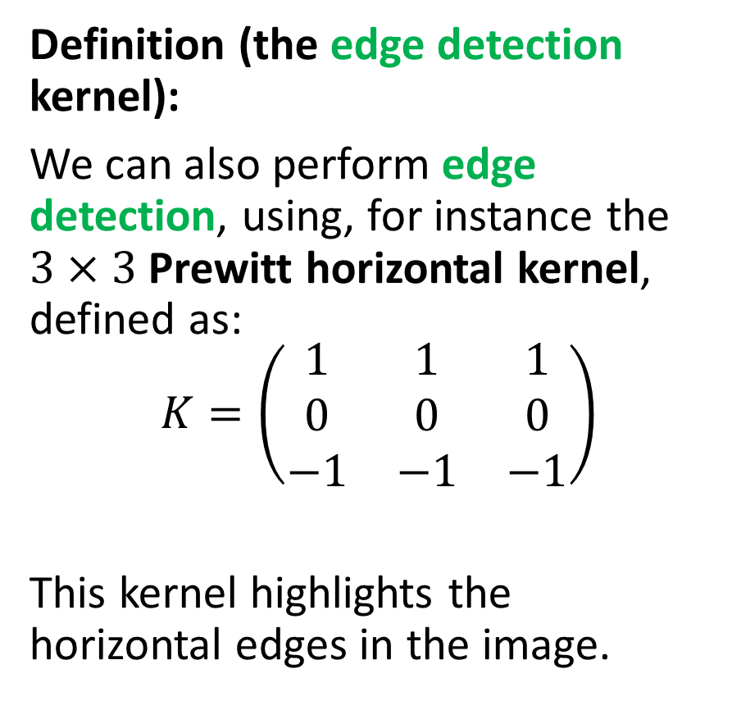
Testing convolution on images
Definition (the edge detection kernel):
We can also perform edge detection, using, for instance the $3×3$ Prewitt horizontal kernel, defined as:
$$K=\left(\begin{matrix}1 & 1 & 1 \\ 0 & 0 & 0 \\ −1 & −1 & −1\end{matrix}\right)$$
This kernel highlights the horizontal edges in the image.

Slide 32
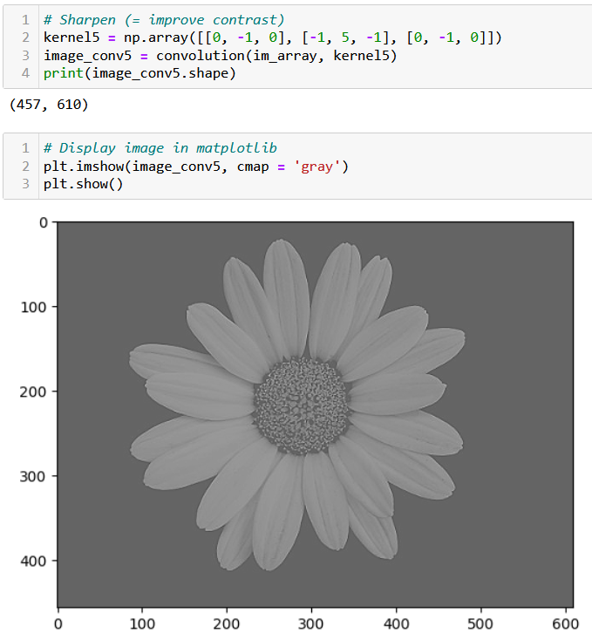
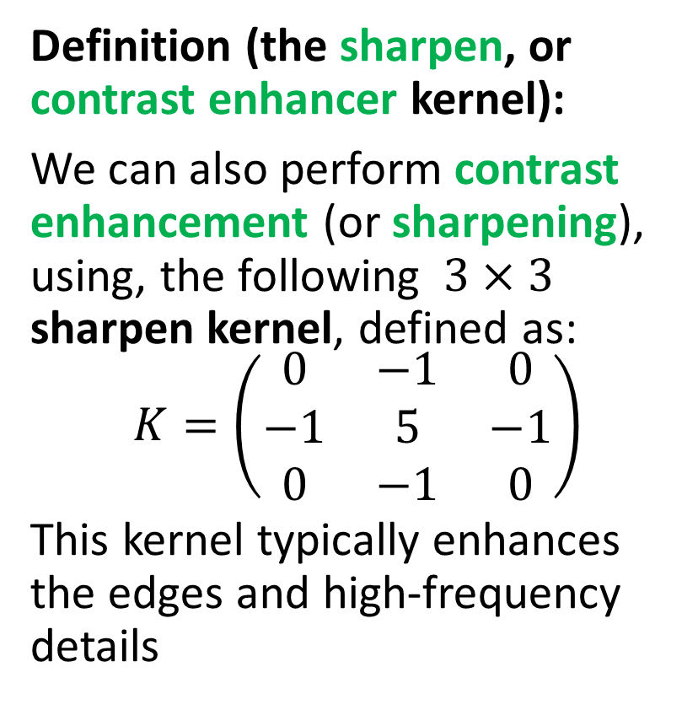
Testing convolution on images
Definition (the sharpen, or contrast enhancer kernel):
We can also perform contrast enhancement (or sharpening), using, the following $3×3$ sharpen kernel, defined as:
$$K=\left(\begin{matrix}0 & −1 & 0 \\ −1 & 5 & −1 \\ 0 & −1 & 0\end{matrix}\right)$$
This kernel typically enhances the edges and high-frequency details

Slide 34
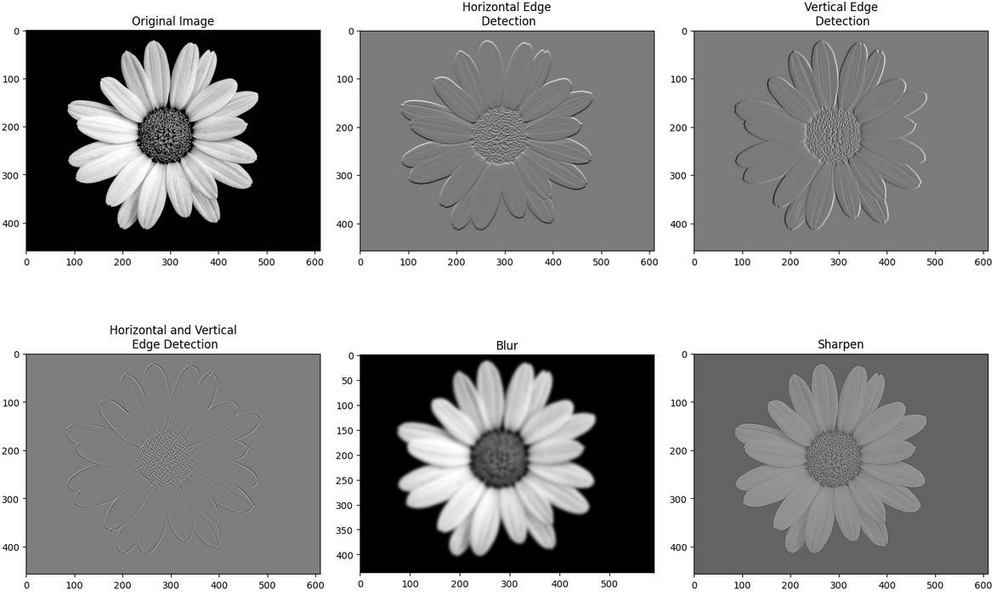
Many transformation kernels exist

Slide 35
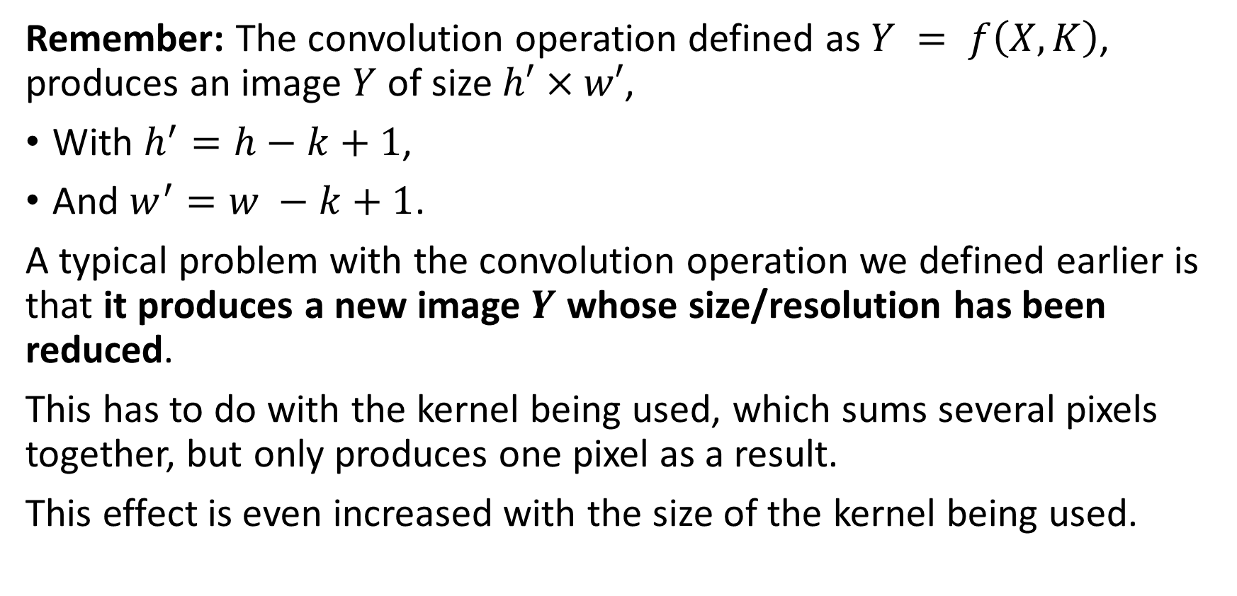
Downsizing
Remember: The convolution operation defined as $Y = f\left(X, K\right)$, produces an image $Y$ of size $h′×w′$,
With $h^{′}=h−k+1$,
And $w^{′}=w −k+1$.
A typical problem with the convolution operation we defined earlier is that it produces a new image $Y$ whose size/resolution has been reduced.
This has to do with the kernel being used, which sums several pixels together, but only produces one pixel as a result.
This effect is even increased with the size of the kernel being used.

Slide 36
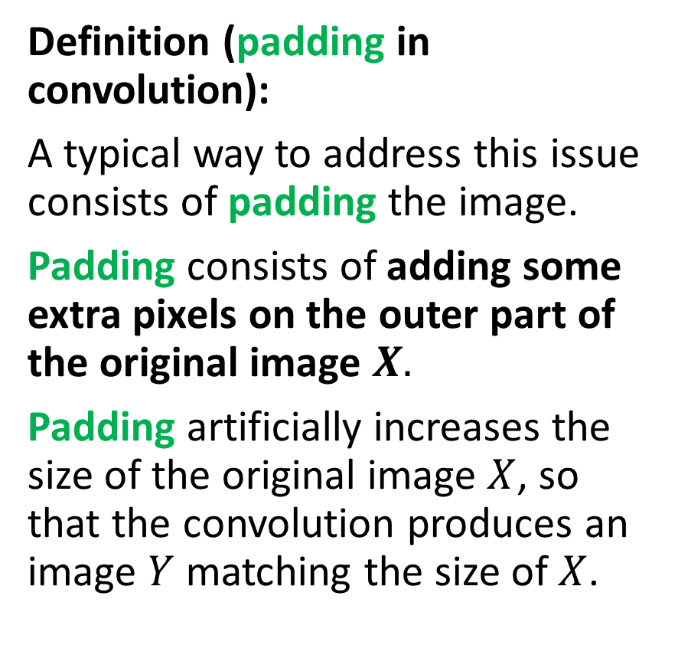
Adding some padding
Definition (padding in convolution):
A typical way to address this issue consists of padding the image.
Padding consists of adding some extra pixels on the outer part of the original image $X.$
Padding artificially increases the size of the original image $X$, so that the convolution produces an image $Y$ matching the size of $X$.
Three possible patterns for padding exist:
Valid/Same padding,
Zero padding,
Other types of padding…
This is typically be used to maintain the spatial dimensions of the input image and prevent the spatial dimensions of the output from getting too small.

Slide 37




Adding some padding
Valid padding: default configuration, no padding is applied to the input data. The convolution operation is only performed only on the valid parts of the input and the output size is then smaller than the input size.
$$Y = f(X, K)$$
$$K$$
$$Y$$
$$X$$

Slide 38

Adding some padding
Same padding: The number of zeros added (i.e. padding size $p$) is defined so that the image $Y$ has the same size as image $X$.
Zero padding: added pixels can simply be set to have the value 0.
0 | 0 | 0 | 0 | 0 | 0 | 0
0 |  |  |  |  |  | 0
0 |  |  |  |  |  | 0
0 |  |  |  |  |  | 0
0 |  |  |  |  |  | 0
0 |  |  |  |  |  | 0
0 | 0 | 0 | 0 | 0 | 0 | 0
$$Y = f(X, K)$$
$$K$$
$$Y$$
$$X$$

Slide 39
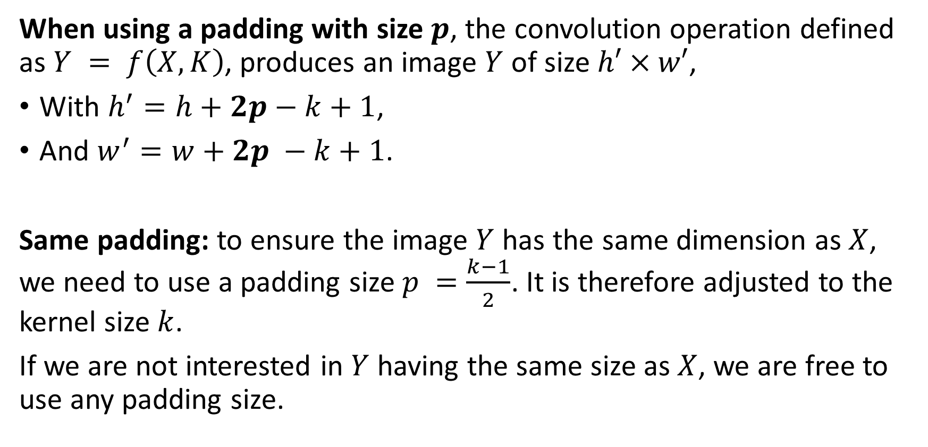
Adding some padding
When using a padding with size $p$, the convolution operation defined as $Y = f\left(X, K\right)$, produces an image $Y$ of size $h′×w′$,
With $h^{′}=h+2p−k+1$,
And $w^{′}=w+2p −k+1$.
Same padding: to ensure the image $Y$ has the same dimension as $X$, we need to use a padding size $p =\frac{k−1}{2}$. It is therefore adjusted to the kernel size $k$.
If we are not interested in $Y$ having the same size as $X$, we are free to use any padding size.

Slide 40

Adding some padding
Interpolation padding: instead of zeros, added pixels have the value of the closest pixel. Can also “zoom in” the original image and resize it to the expected number of pixels we want for image $X$ after padding.
1 | 1 | 5 | 5 | 2 | 4 | 4
1 | 1 | 5 | 5 | 2 | 4 | 4
2 | 2 | 4 | 5 | 2 | 2 | 2
3 | 3 | 1 | 1 | 1 | 1 | 1
4 | 4 | 4 | 7 | 2 | 3 | 3
5 | 5 | 0 | 0 | 3 | 1 | 1
5 | 5 | 0 | 0 | 0 | 1 | 1
$$Y = f(X, K)$$
$$K$$
$$Y$$
$$X$$

Slide 41
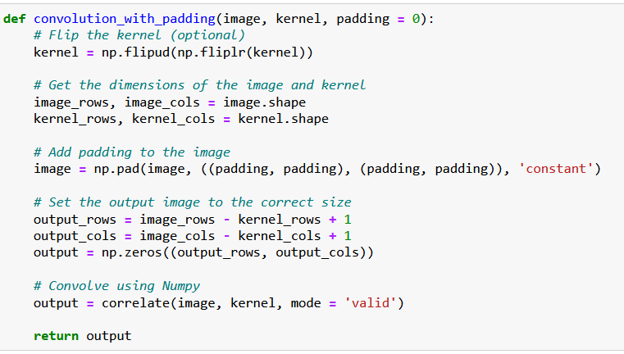
Adding some padding
Padding is simply implemented using the pad() functions,
It adds a layer of zeroes to the matrix image, of size padding on top, bottom, right and left side of the image matrix.

Slide 42
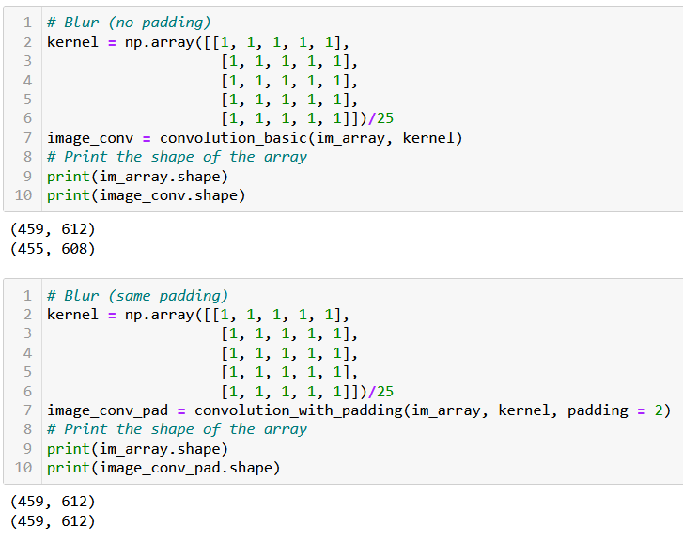
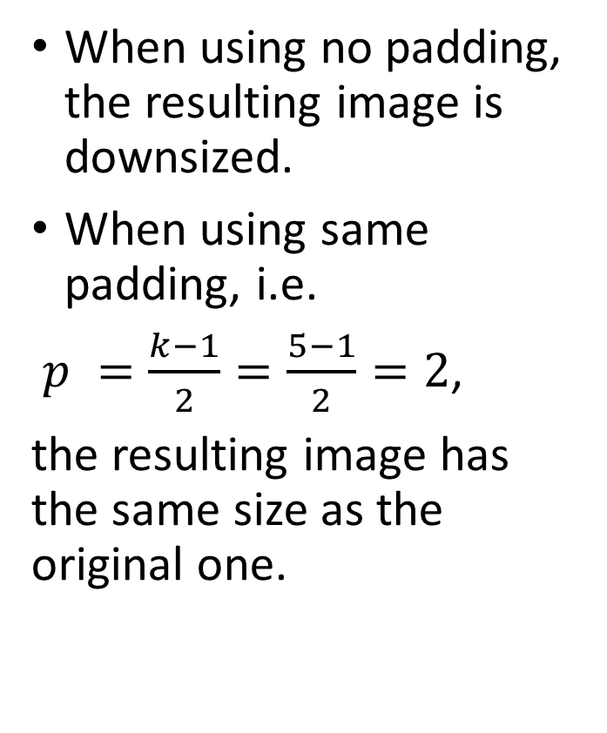
Adding some padding
When using no padding, the resulting image is downsized.
When using same padding, i.e.
$p =\frac{k−1}{2}=\frac{5−1}{2}=2$,
the resulting image has the same size as the original one.

Slide 43
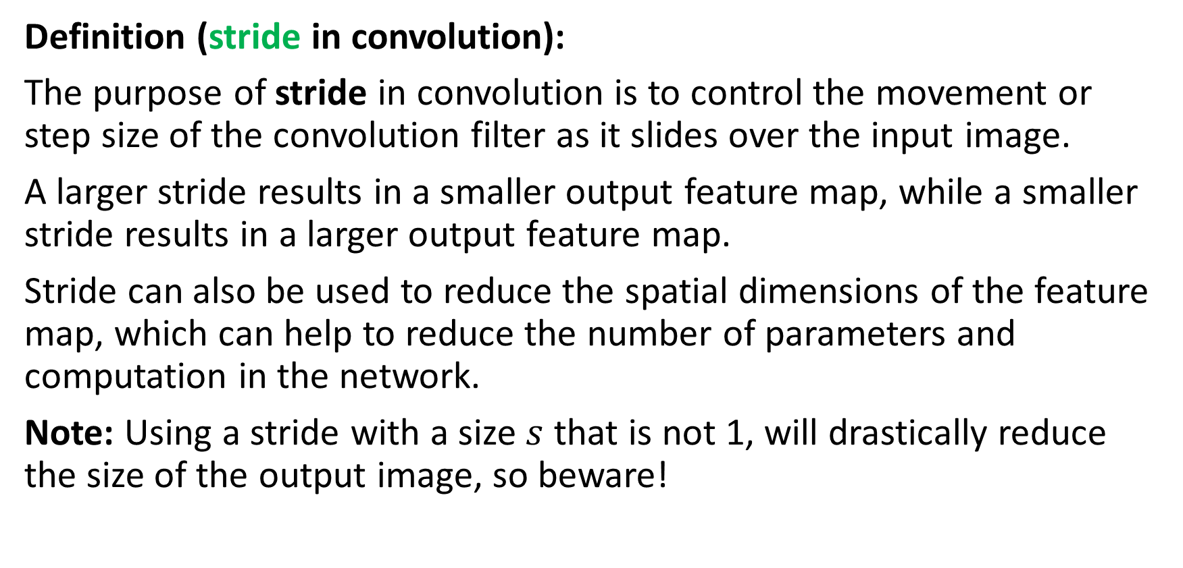
Adding a stride
Definition (stride in convolution):
The purpose of stride in convolution is to control the movement or step size of the convolution filter as it slides over the input image.
A larger stride results in a smaller output feature map, while a smaller stride results in a larger output feature map.
Stride can also be used to reduce the spatial dimensions of the feature map, which can help to reduce the number of parameters and computation in the network.
Note: Using a stride with a size $s$ that is not 1, will drastically reduce the size of the output image, so beware!

Slide 44

Adding a stride
Below, we demonstrate what a stride of size $s = 2$does (no padding).
First, use the convolution as before, next elements to be used are “two steps” away from the first position, and so on.
1 | 1 | 5 | 5 | 2 | 4 | 4
1 | 1 | 5 | 5 | 2 | 4 | 4
2 | 2 | 4 | 5 | 2 | 2 | 2
3 | 3 | 1 | 1 | 1 | 1 | 1
4 | 4 | 4 | 7 | 2 | 3 | 3
5 | 5 | 0 | 0 | 3 | 1 | 1
5 | 5 | 0 | 0 | 0 | 1 | 1
…
$$Y = f(X, K)$$
$$K$$
$$Y$$
$$X$$

Slide 45
Adding a stride
Below, we demonstrate what a stride of size $s = 2$does (no padding).
First, use the convolution as before, next elements to be used are “two steps” away from the first position, and so on.
1 | 1 | 5 | 5 | 2 | 4 | 4
1 | 1 | 5 | 5 | 2 | 4 | 4
2 | 2 | 4 | 5 | 2 | 2 | 2
3 | 3 | 1 | 1 | 1 | 1 | 1
4 | 4 | 4 | 7 | 2 | 3 | 3
5 | 5 | 0 | 0 | 3 | 1 | 1
5 | 5 | 0 | 0 | 0 | 1 | 1
… | …
$$Y = f(X, K)$$
$$K$$
$$Y$$
$$X$$

Slide 46
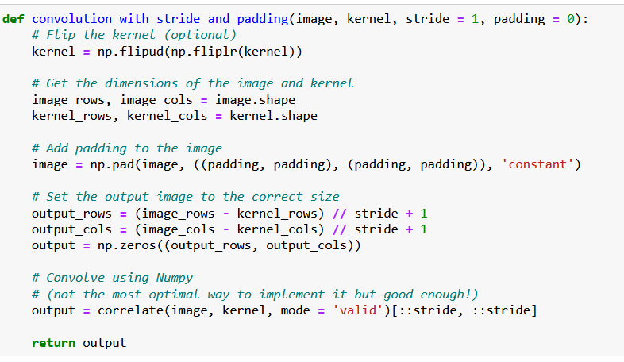
Adding a stride
Stride is easily implemented by using a slicing in the result of the correlation.
This is not the most optimized way to do it, however!
(We do not care so much, as we will use the PyTorch version of convolution after this!)

Slide 47
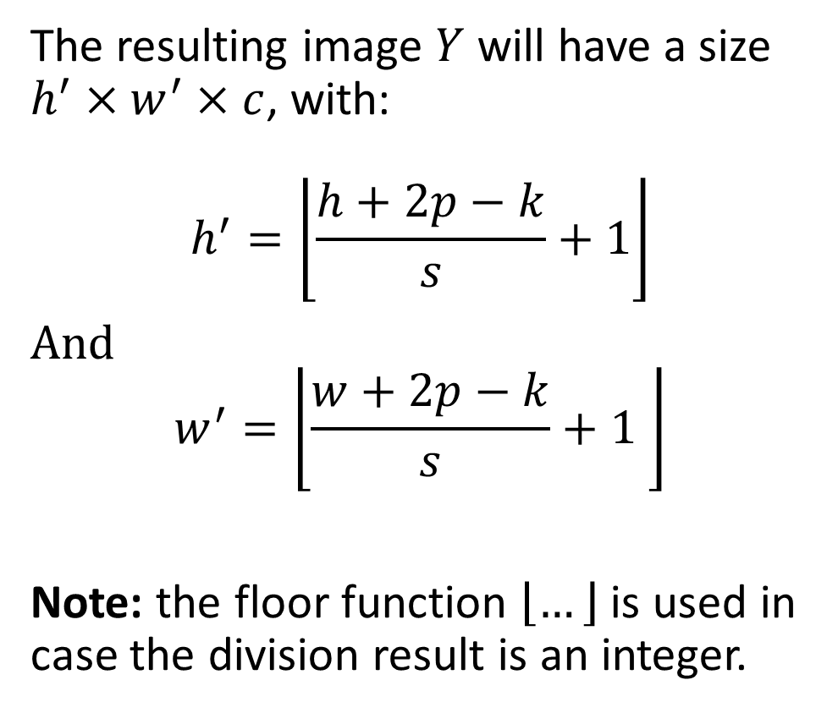
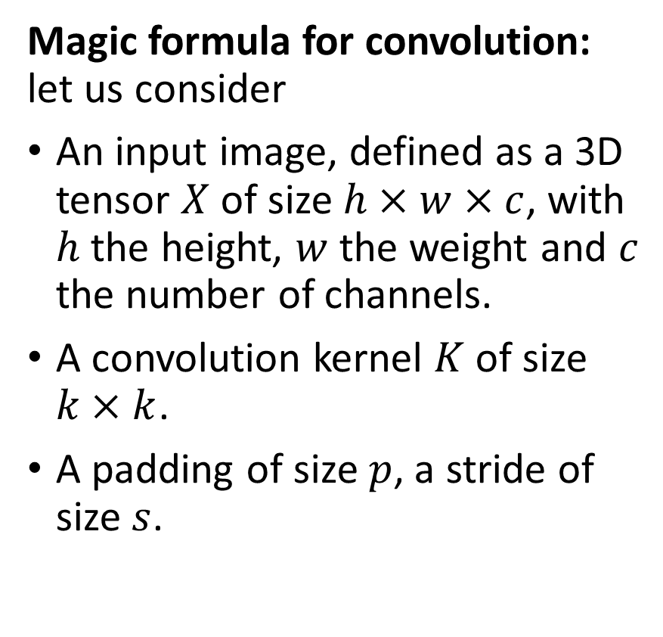
The (final) magic formula for convolution
Magic formula for convolution: let us consider
An input image, defined as a 3D tensor $X$ of size $h×w×c$, with $h$ the height, $w$ the weight and $c$ the number of channels.
A convolution kernel $K$ of size $k×k$.
A padding of size $p$, a stride of size $s$.
The resulting image $Y$ will have a size $h^{′}×w^{′}×c$, with:
$$h^{′}=\left\lfloor \frac{h+2p−k}{s}+1\right\rfloor$$
And $$w^{′}=\left\lfloor \frac{w+2p−k}{s}+1 \right\rfloor$$
Note: the floor function $\left\lfloor …\right\rfloor$ is used in case the division result is an integer.

Slide 48
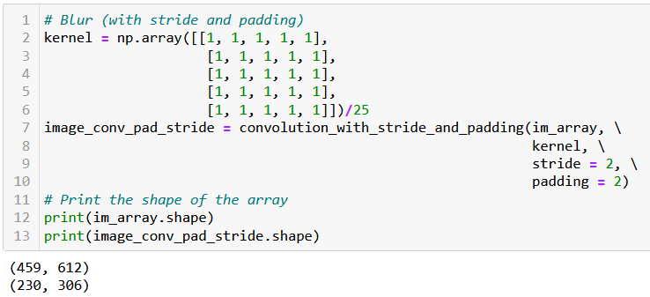
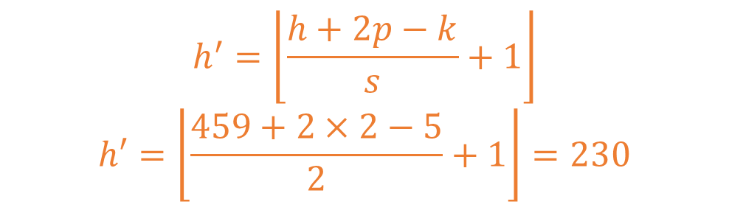
Adding a stride
$$h^{′}=\left\lfloor \frac{h+2p−k}{s}+1\right\rfloor$$
$$h′=\left\lfloor \frac{459+2×2−5}{2}+1\right\rfloor =230$$

Slide 49
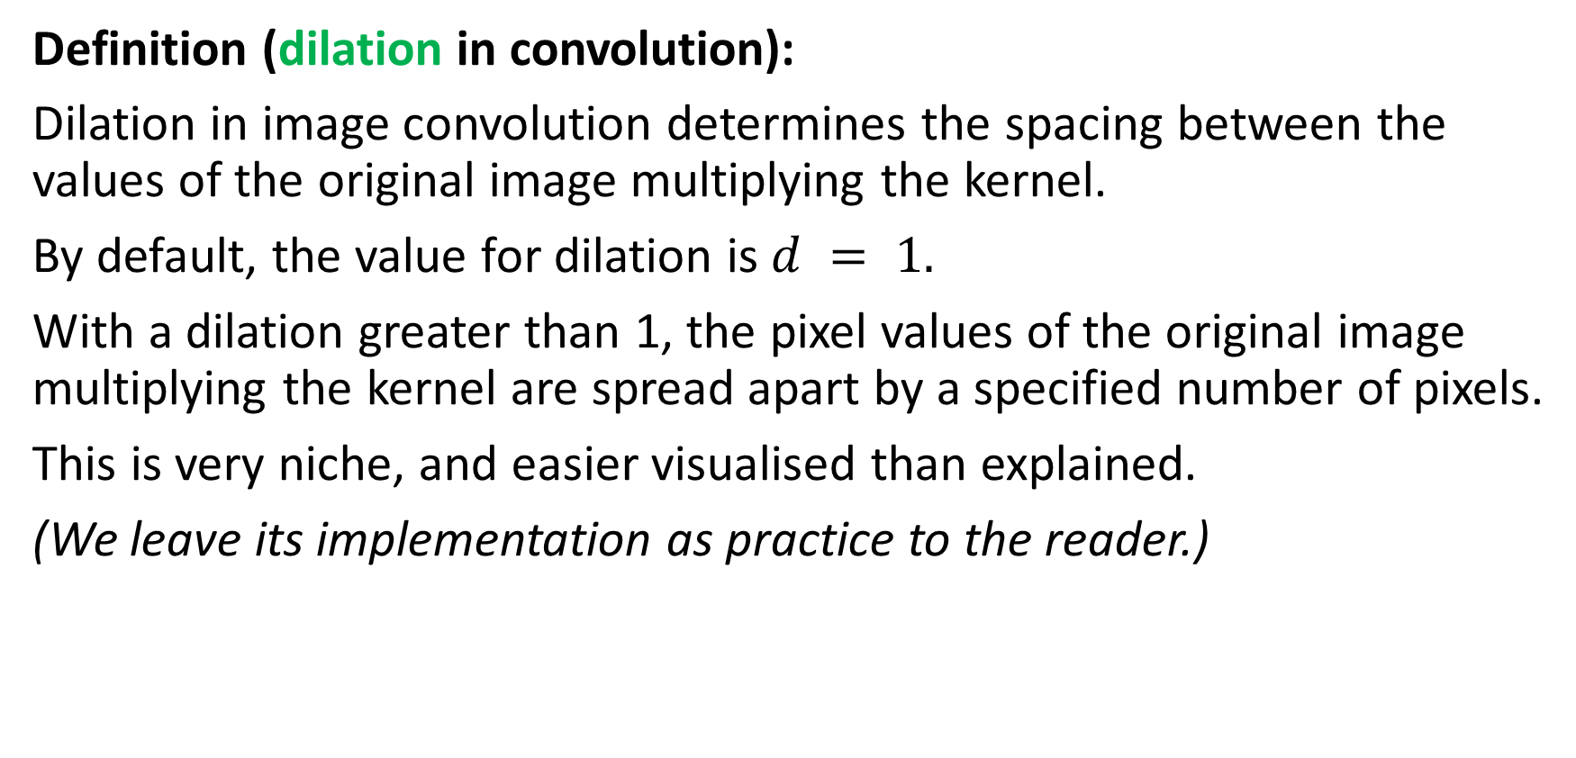
Adding a dilation
Definition (dilation in convolution):
Dilation in image convolution determines the spacing between the values of the original image multiplying the kernel.
By default, the value for dilation is $d = 1.$
With a dilation greater than 1, the pixel values of the original image multiplying the kernel are spread apart by a specified number of pixels.
This is very niche, and easier visualised than explained.
(We leave its implementation as practice to the reader.)

Slide 50

Adding a dilation
Below, we demonstrate what a dilation of size $d = 2$does. Stride is set to 1, padding is 0.
1 | 1 | 5 | 5 | 2 | 4 | 4
1 | 1 | 5 | 5 | 2 | 4 | 4
2 | 2 | 4 | 5 | 2 | 2 | 2
3 | 3 | 1 | 1 | 1 | 1 | 1
4 | 4 | 4 | 7 | 2 | 3 | 3
5 | 5 | 0 | 0 | 3 | 1 | 1
5 | 5 | 0 | 0 | 0 | 1 | 1
…
$$Y = f(X, K)$$
$$K$$
$$Y$$
$$X$$

Slide 51
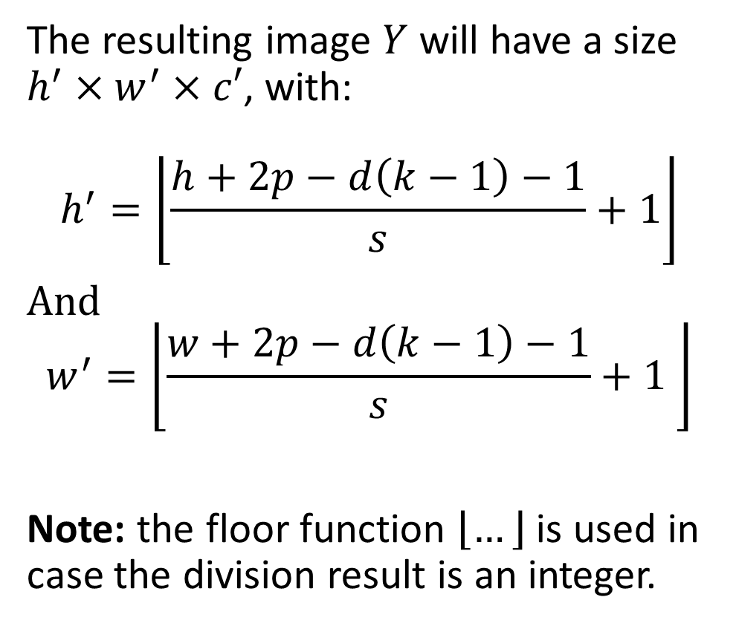
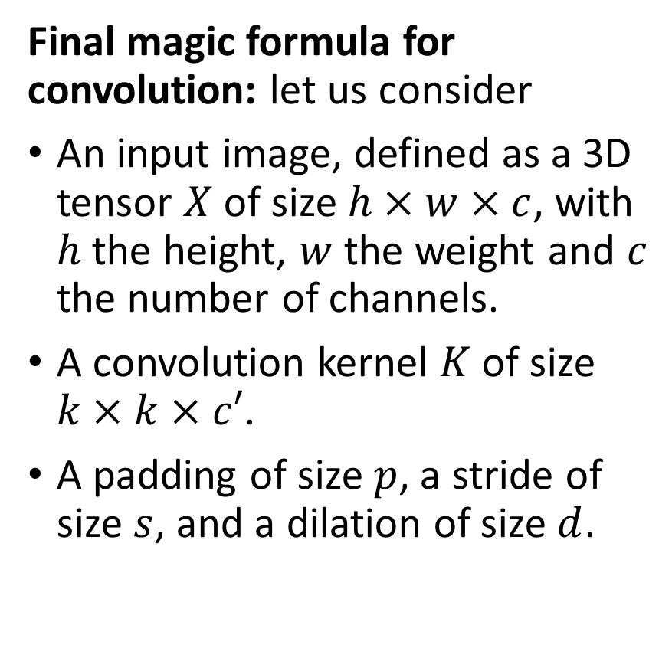
The (final) magic formula for convolution
Final magic formula for convolution: let us consider
An input image, defined as a 3D tensor $X$ of size $h×w×c$, with $h$ the height, $w$ the weight and $c$ the number of channels.
A convolution kernel $K$ of size $k×k×c′$.
A padding of size $p$, a stride of size $s$, and a dilation of size $d$.
The resulting image $Y$ will have a size $h^{′}×w^{′}×c′$, with:
$$h^{′}=\left\lfloor \frac{h+2p−d\left(k−1\right)−1}{s}+1\right\rfloor$$
And $$w^{′}=\left\lfloor \frac{w+2p−d\left(k−1\right)−1}{s}+1 \right\rfloor$$
Note: the floor function $\left\lfloor …\right\rfloor$ is used in case the division result is an integer.

Slide 52
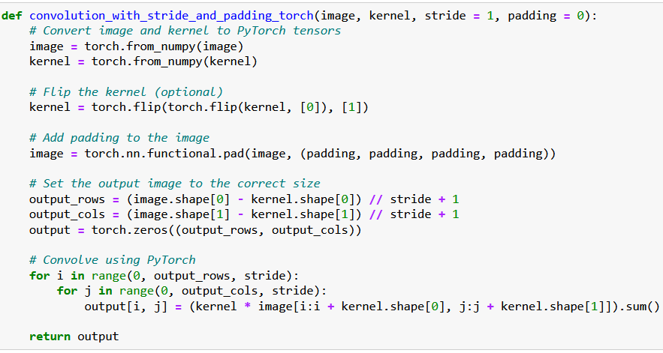
Implementing a custom Conv in PyTorch

Slide 53
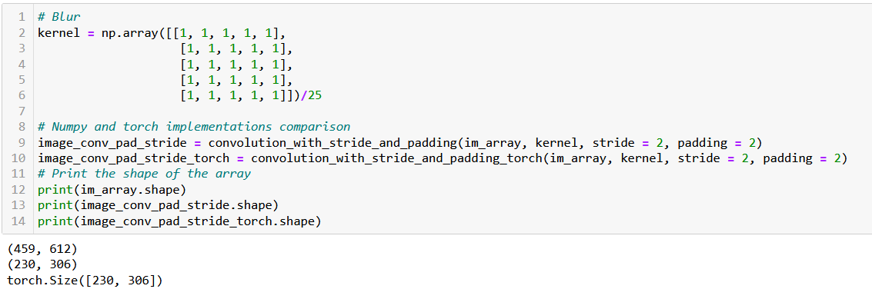
Implementing a custom Conv in PyTorch
The PyTorch and the Numpy implementations are indeed equivalent.

Slide 54
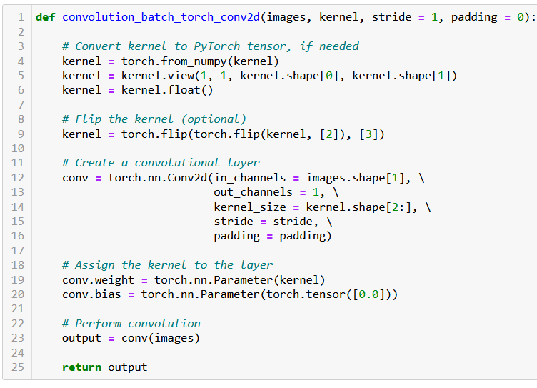
The Conv2d in PyTorch
PyTorch has a Conv2d function implementing said convolution.
We will rely on it from now on.

Slide 55
The Conv2d in PyTorch
Note, however that this layer has two trainable parameters:
Weight (which is our kernel, whose values will be decided later during training).
Bias (which was not there before?)

Slide 56
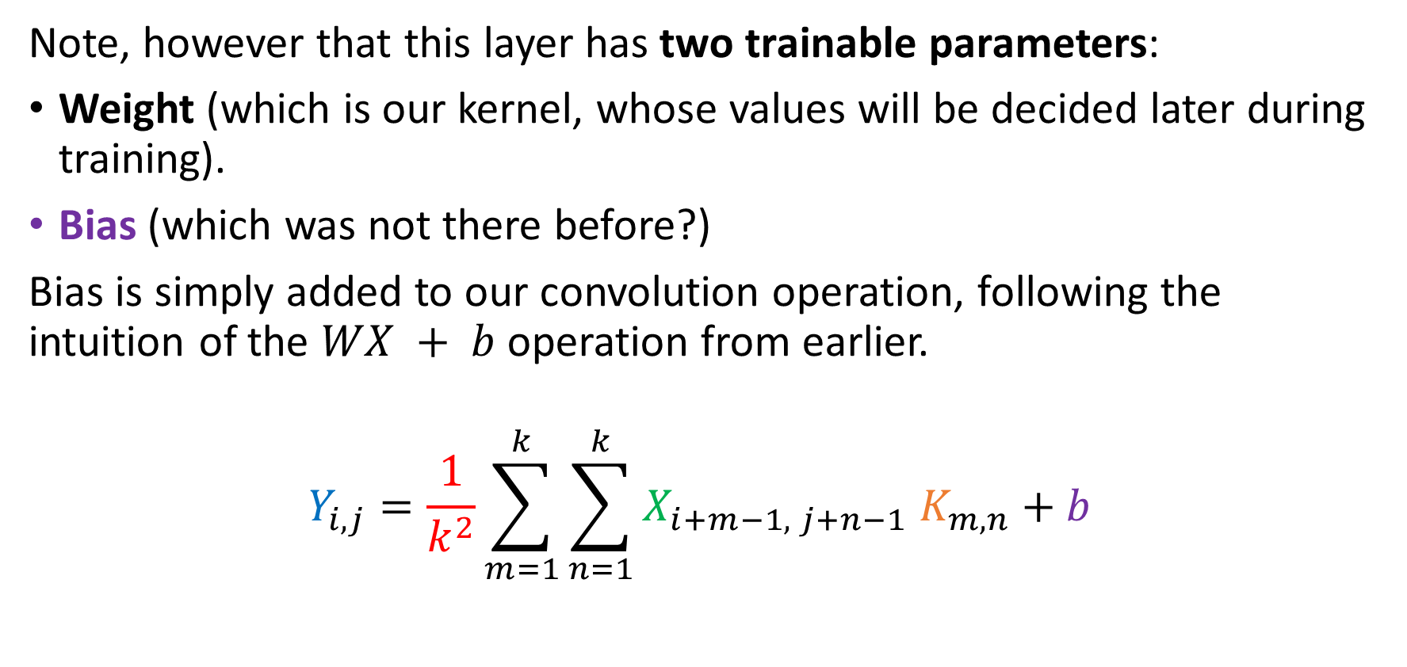
The Conv2d in PyTorch
Note, however that this layer has two trainable parameters:
Weight (which is our kernel, whose values will be decided later during training).
Bias (which was not there before?)
Bias is simply added to our convolution operation, following the intuition of the $WX + b$operation from earlier.
$$Y_{i,j}=\frac{1}{k^{2}}\sum_{m=1}^{k}{\sum_{n=1}^{k}{X_{i+m−1, j+n−1} K_{m,n}}}+b$$

Slide 57

The Conv2d in PyTorch
In the PyTorch Conv2d operations however, the input images $X$ need to be formatted as a 4D tensor of size $N_{s}×c×h×w$, with
$N_{s}$, the number of samples/images in batch of data $X$,
$c$ , the number of channels in images of batch $X$ (e.g. greyscale = 1, RGB = 3),
$h$ , the height for images batch of data $X$,
$w$ , the width for images batch of data $X$.
Same thing for the kernel

Slide 58

The Conv2d in PyTorch
This is the reason for reshaping the kernel
from a 2D NumPy array of size $\left(k, k\right)$,
to a 4D PyTorch tensor of size $(1, 1, k, k)$.
Eventually flipping the kernel along the last two dimensions.

Slide 59


If we use the MNIST dataloader…
MNIST dataloader will give batches of data as 4D tensors of shape $N_{s}×c×h×w$, with:
$N_{s}$, being batch size (here, 256),
$c$ , the number of channels (here, 1),
$h$ , the height for images (here, 28),
$w$ , the height for images (here, 28).

Slide 60

If we use the MNIST dataloader…
Not using a padding, stride 1, and kernel size is 5.
Our magic formula from earlier then gives:
$$28+ 2×0−5+1=24.$$

Slide 61
A quick word on higher dimensions
So far, we have implemented the convolution operation on images that were greyscale (either our flower image or the MNIST dataset).
What happens when playing with higher dimension images, i.e. images that have more than one channel (e.g. RGB)?

Slide 62




Convolution on high dim
1 | 2 | 4 | 2 | 1
4 | 7 | 3 | 2 | 1
4 | 5 | 2 | 3 | 1
2 | 1 | 7 | 8 | 4
3 | 2 | 4 | 7 | 8
1 | 2 | 4 | 2 | 1
4 | 7 | 3 | 2 | 1
4 | 5 | 2 | 3 | 1
2 | 1 | 7 | 8 | 4
3 | 2 | 4 | 7 | 8
1 | 2 | 4 | 2 | 1
4 | 7 | 3 | 2 | 1
4 | 5 | 2 | 3 | 1
2 | 1 | 7 | 8 | 4
3 | 2 | 4 | 7 | 8
$$X$$
In the case of RGB images, the resulting matrix $Y$ is then of size $h^{′}×w^{′}×3$.
The pixel values $y_{i,j, l}$for image $Y$ are calculated using the convolution operation, on each channel separately.
We then define pixels $Y_{i,j,l}$, $∀i∈\left[1, h^{′}\right], j∈\left[1,w^{′}\right], ∀l∈[1, 3]$:
$$Y_{i,j,l}=\frac{1}{k^{2}}\sum_{m=1}^{k}{\sum_{n=1}^{k}{X_{i+m−1, j+n−1,l} K_{m,n}}}+b$$
1 | 0 | 1
0 | 2 | 1
1 | 0 | 1
$$K$$
$$…$$ | … | …
… | … | …
… | $$\frac{39}{9}$$ | …
$$…$$ | … | …
… | … | …
… | $$\frac{39}{9}$$ | …
$$Y$$
$$\frac{28}{9}$$ | … | …
… | … | …
… | $$\frac{39}{9}$$ | …
This operation preserves the original number of channels of original image $X$, producing a new RGB image $Y$ as a result.

Slide 63






Convolution on high dim
1 | 2 | 4 | 2 | 1
4 | 7 | 3 | 2 | 1
4 | 5 | 2 | 3 | 1
2 | 1 | 7 | 8 | 4
3 | 2 | 4 | 7 | 8
1 | 2 | 4 | 2 | 1
4 | 7 | 3 | 2 | 1
4 | 5 | 2 | 3 | 1
2 | 1 | 7 | 8 | 4
3 | 2 | 4 | 7 | 8
1 | 2 | 4 | 2 | 1
4 | 7 | 3 | 2 | 1
4 | 5 | 2 | 3 | 1
2 | 1 | 7 | 8 | 4
3 | 2 | 4 | 7 | 8
$$X$$
More generally, however: if you define the kernel as a tensor with its own number of channels $k_{d}≠1$…
We then define pixels $Y_{i,j,l}$, $∀i∈\left[1, h^{′}\right], j∈\left[1,w^{′}\right], ∀l∈[1, k_{d}]$:
$$Y_{i,j,l}=\frac{1}{k^{2}}\sum_{m=1}^{k}{\sum_{n=1}^{k}{\sum_{l^{′}=1}^{3}{X_{i+m−1, j+n−1,l^{′}} K_{m,n,l}}}}+b$$
This operation will then produce a new image $Y$, whose number of channels matches the one of the kernel $K$, as a result, i.e. $h^{′}×w^{′}×k_{d}$.
1 | 0 | 1
0 | 2 | 1
1 | 0 | 1
1 | 0 | 1
0 | 2 | 1
1 | 0 | 1
$$K$$
1 | 0 | 1
0 | 2 | 1
1 | 0 | 1
$$…$$ | … | …
… | … | …
… | $$\frac{39}{9}$$ | …
$$…$$ | … | …
… | … | …
… | $$\frac{39}{9}$$ | …
$$Y$$
$$\frac{28}{9}$$ | … | …
… | … | …
… | $$\frac{39}{9}$$ | …

Slide 64


Conv2d layer
Definition (the Conv2d layer):
The Conv2d layer is Pytorch’s implementation of the convolution operation we have seen earlier.
The first two integer values correspond to the number of channels of input images $X$ and the number of channels in kernel.
The convolution layer below then expects grayscale images $X$ with only one channel and will produce images $Y$ with 32 channels.
→ What is this image with 32 channels?

Slide 65

Convolution on high dim
→ What is this image with 32 channels?
We could visualize that as 32 convolutions operations on our grayscale images $X$, being run on parallel with 32 different kernels.
Kernels could correspond to different operations (blur, sharpen, edge detection, etc.).

Slide 66

Chaining convolutions
→ What is this image with 32 channels?
We could visualize that as 32 convolutions operations on our grayscale images $X$, being run on parallel with 32 different kernels.
Kernels could correspond to different operations (blur, sharpen, edge detection, etc.).
Eventually chaining several convolutions, will lead to combining operations together.

Slide 67

Chaining convolutions
For instance: recognizing a cat ear = two edge detections, then combined to recognize a triangular shape or some sort?

Slide 68
The core idea behind CNN
Definition (Convolutional Neural Networks):
Introduced in [LeCun1998], Convolutional Neural Networks (or CNNs in short) are Neural Networks which integrate convolutions as the processing operations to be used on input images, in place of the Linear ones.
Training a CNN is then equivalent to letting the Neural Network decide on which kernels values (and therefore image processing operations) to use in the convolution operations run in both parallel and sequence.

Slide 69
Training a CNN
CNNs have shown much better performance at processing images data types, compared to Neural Networks implementing Linear operations only.
For this reason, Convolutions (and CNNs) are indeed the preferred processing method when inputs are images.
In addition, as the convolution is “just another weird matrix multiplication of some sort”, this means that the trainable parameters (weight/kernel and bias) could be trained using the same backpropagation as earlier!
(We will however not implement it and rely on autograd!)

Slide 70
Our first CNN on MNIST
We will therefore build our first Convolutional Neural Network (CNN).
This network will have the same logic as the previous DNN from last week, but it will replace the first few Linear layers with Conv2d operations instead.
By doing so, we are hoping that the CNN will be able to figure out which kernel values (and image processing operations) to use, for the MNIST classification task.
The final layers must consist of Linear layers, whose purpose is to eventually produce a vector of 10 values, probabilities for each class.
Between the last Conv2d (which produces a 2D image) and the first fully connected vector (which expects a 1D vector), we will implement a flattening of the image, as before.

Slide 71
Our first CNN on MNIST
Our CNN: 2 Conv2d layers + Flatten + 2 Linear layers
Batch of 256 greyscale MNIST images (256, 1, 28, 28)
First Conv2d, with same padding (256, 32, 28, 28)
Second Conv2d, with same padding (256, 64, 28, 28)
Flatten in 1D vector (256, 50176)
First Linear Layer (256, 128)
Second Linear Layer (256, 10)

Slide 72

Our first CNN on MNIST
Our CNN: 2 Conv2d layers + Flatten + 2 Linear layers

Slide 73

Our first CNN on MNIST
Our CNN: 2 Conv2d layers + Flatten + 2 Linear layers
Define the sequence of operations in the forward method as before.
Good practice: We will print the shape of each layer output to confirm sizes produced by each layer.

Slide 74


Our first CNN on MNIST
Good practice: We will show the modules/layers in our CNN, and print the shape of each layer output to confirm sizes produced by each layer.

Slide 90
Conclusion (Week 4)
XXX
XXX

Slide 91
Learn more about these topics
Out of class, supporting papers, for those of you who are curious.
[LeCun1998] Y. LeCun, L. Bottou, Y. Bengio, and P. Haffner, “Gradient-Based Learning Applied to Document Recognition”, 1998.

Slide 92
Learn more about these topics
Some extra (easy) reading and videos for those of you who are curious.
[XXX] XXX

